Slide 1
Computer Graphics
Lab2 – Applying transformations

Slide 2
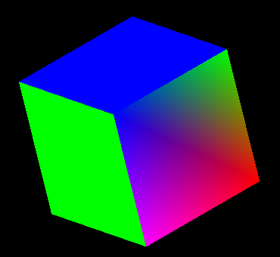
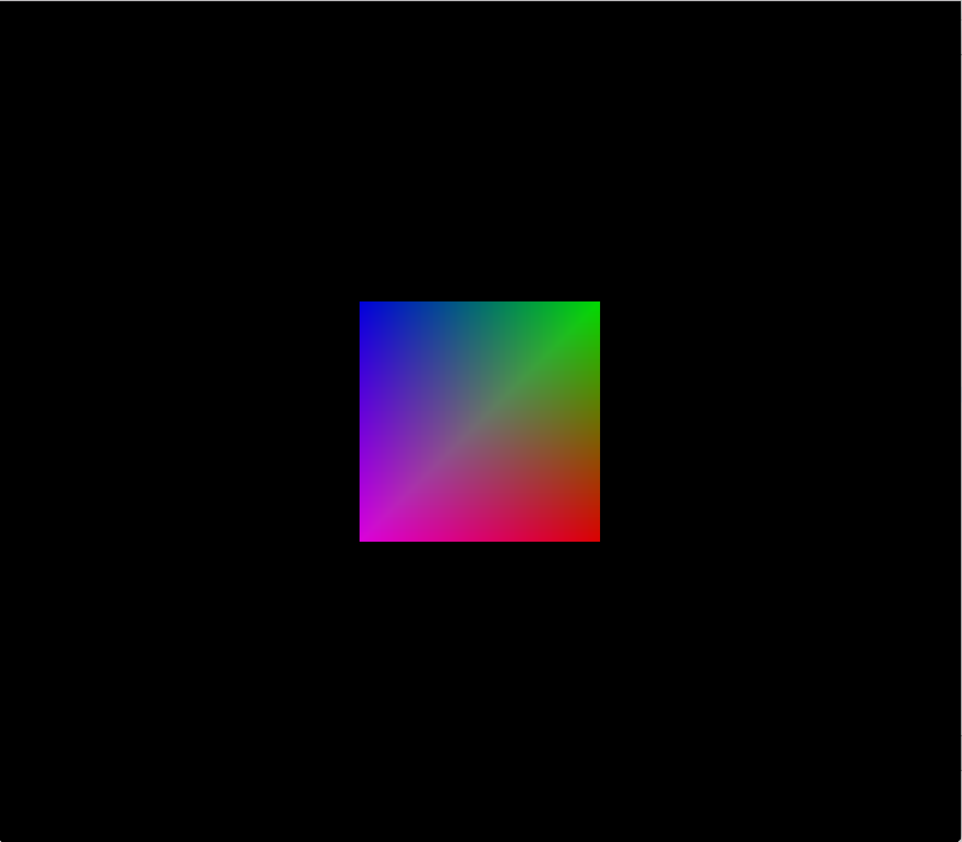
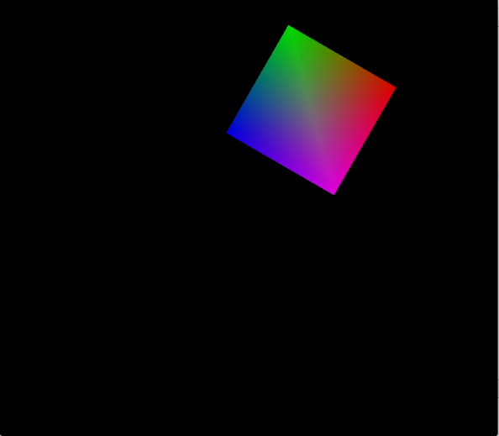
1. Transformations
You have the procedure
DrawCube()
Try below functions with it:
  glTranslatef( );
  glScalef( );
  glRotatef( );

Slide 3
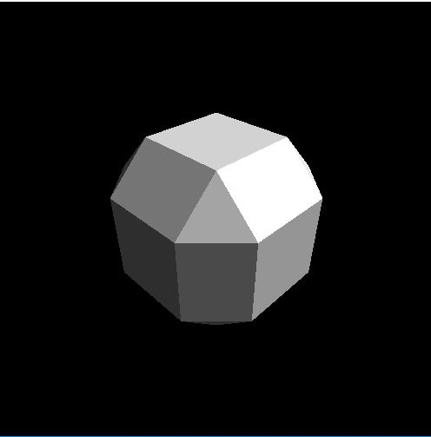
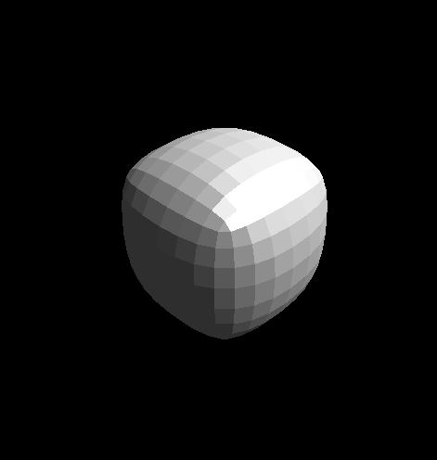
2. Doo-Sabin Subdivision
Draw the L shape in Tetris game
Try to do 1st sudivision using Doo-Sabin subdivision method !!
Try to do more subdivisions …

Slide 4
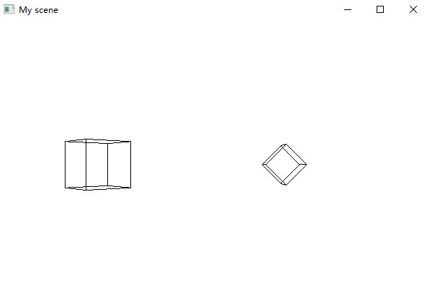
3. Transformations of Wired Cube
Try the function:
  glutWireCube(1.f);
  glTranslatef( );
  glScalef( );
  glRotatef( );

Slide 5
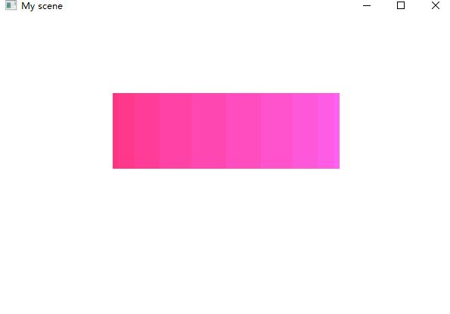
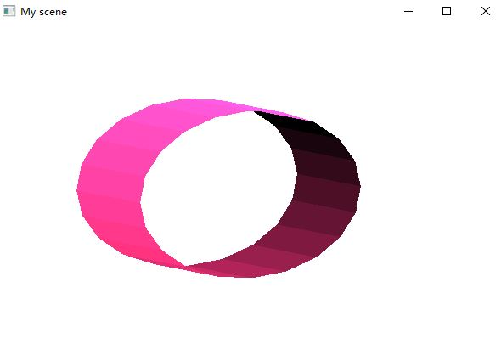
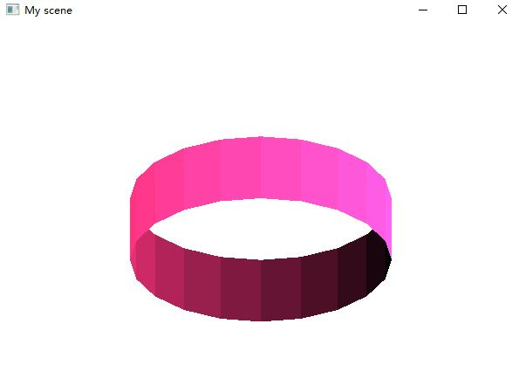
4. Creating a cylinder
Try the function:
  glTranslatef( );
  glScalef( );
  glRotatef( );

Slide 6
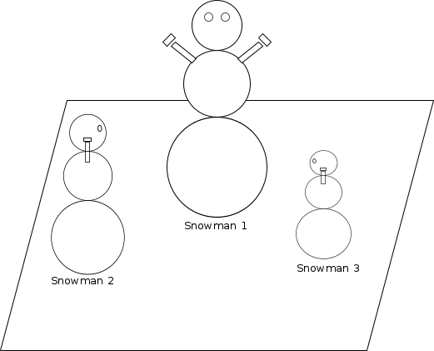
5. Snowman
Create the snowman model:
  You may use glutSolidSphere();
Try the following functions:
  glMatrixMode(GL_MODELVIEW)
  glTranslatef(-8.0, 0.0, 6.0);
  glRotatef(90.0, 0.0, 1.0, 0.0);
  glScalef(0.5, 0.5, 0.5);
  drawSnowman();

